Slide 1

Машинное обучение и нейронные сети
Лекция 7. Градиентная оптимизация и регуляризация свёрточных нейронных сетей

Slide 2
Outline
1. Previous lecture recap: backpropagation, activations, intuition.
2. Optimizers.
3. Data normalization.
4. Regularization.

Slide 3
Recap: Deep Learning basics

Slide 4
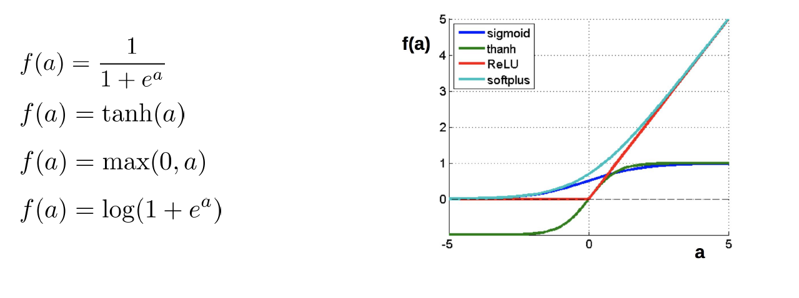
Once more: nonlinearities

Slide 5
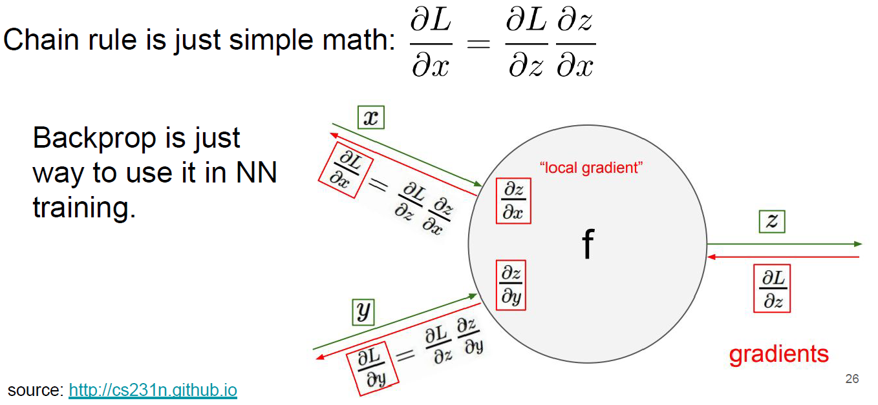
Backpropagation and chain rule

Slide 6
Optimizers
Stochastic gradient descent is used to optimize NN parameters

Slide 7
Optimization: SGD upgrades

Slide 8
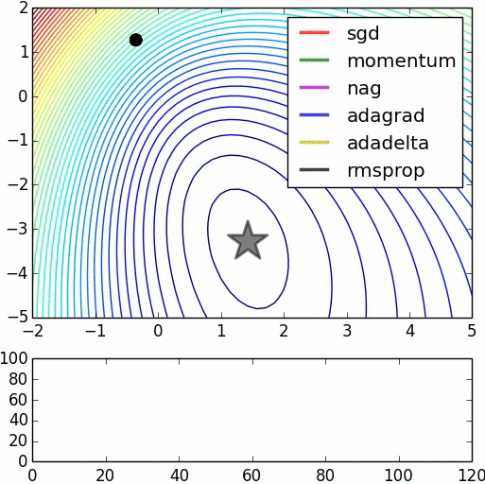
Optimizers
There are much more optimizers:
Momentum
Adagrad
Adadelta
RMSprop
Adam
…
even other NNs

Slide 9
Optimization: SGD
Averaging over too small batches leads to noisy gradient

Slide 10
First idea: momentum
Simple SGD
SGD with momentum

Slide 11
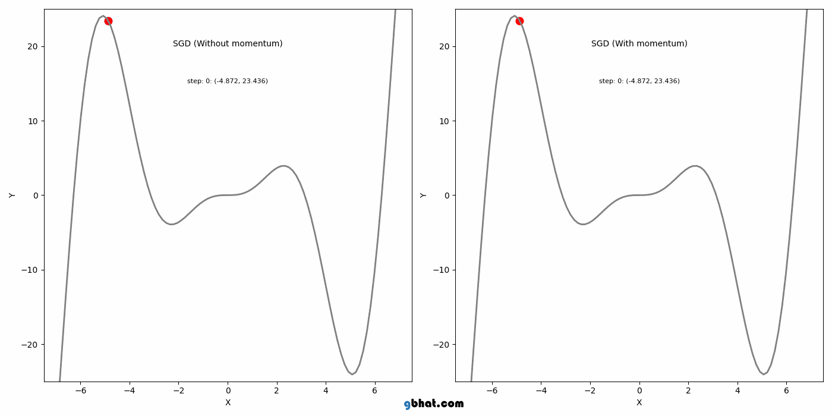

Slide 12
Nesterov momentum

Slide 13
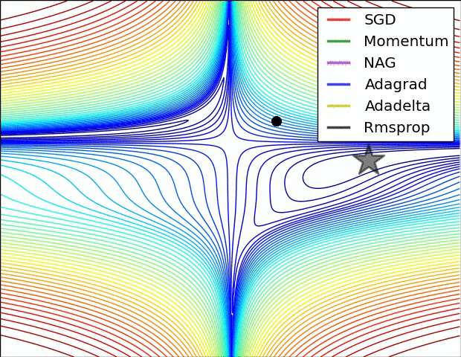
Comparing momentums

Slide 14
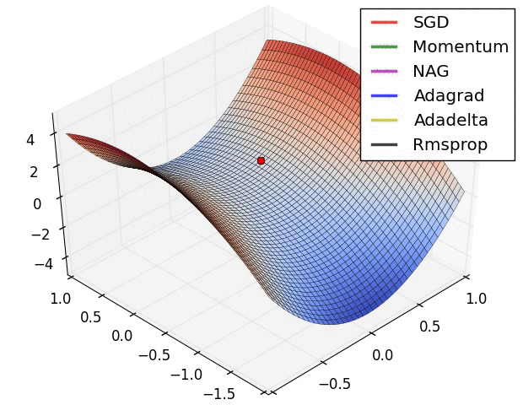

Slide 15
Second idea: different dimensions are different
Adagrad: SGD with cache

Slide 16
Second idea: different dimensions are different
Adagrad: SGD with cache
Problem: gradient fades with time

Slide 17

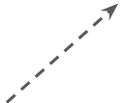
Second idea: different dimensions are different
Adagrad: SGD with cache
RMSProp: SGD with cache with exp. Smoothing
Slide 29 Lecture 6 of Geoff Hinton’s Coursera class

Slide 18
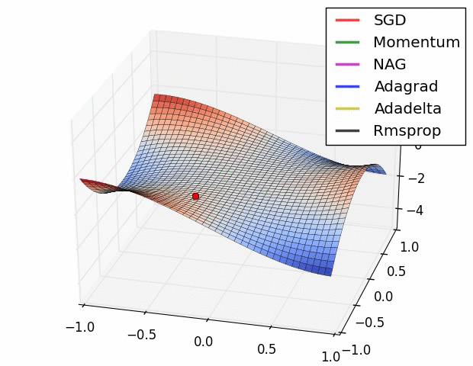

Slide 19
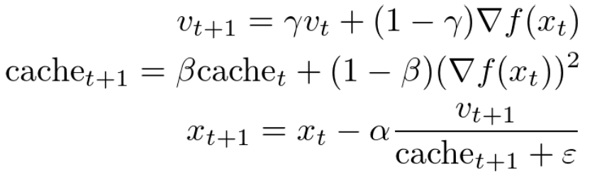
Adam
Let’s combine the momentum idea and RMSProp normalization:
Actually, that’s not quite Adam.

Slide 20
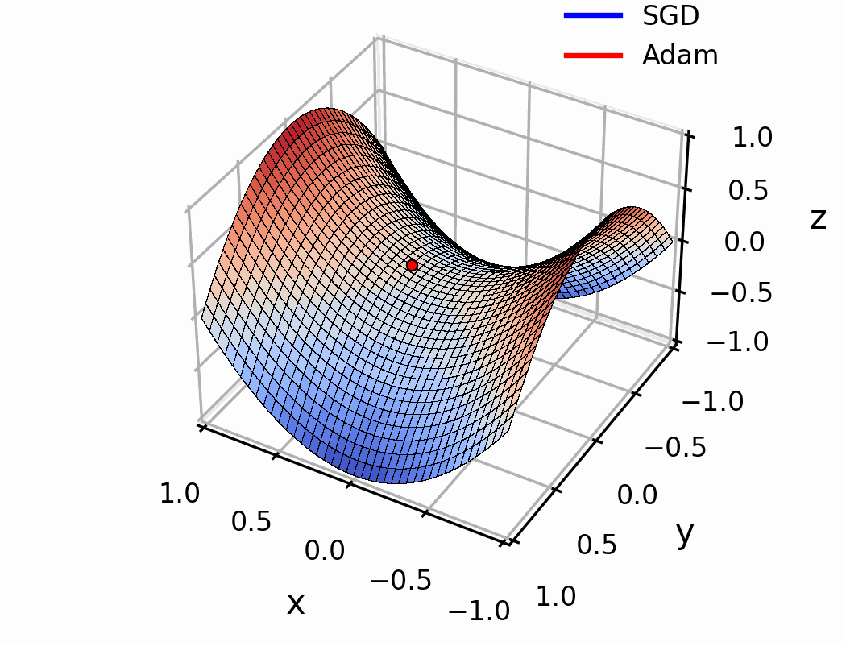

Slide 22
Once more: learning rate

Slide 23
Sum up: optimization
Adam is great basic choice
Even for Adam/RMSProp learning rate matters
Use learning rate decay
Monitor your model quality

Slide 24
Regularization in DL

Slide 26
Data normalization

Slide 27
Data normalization

Slide 28
Batch normalization
Problem:Consider a neuron in any layer beyond first
Consider a neuron in any layer beyond first
At each iteration its weights are tuned to reduce loss
Its inputs are tuned as well. Some of them become larger, some – smaller
Now the neuron needs to be re-tuned for it's new inputs

Slide 29
Batch normalization
TL; DR:
● It's usually a good idea to normalize linear model inputs
(c) Every machine learning lecturer, ever

Slide 30
Batch normalization
Normalize activation of a hidden layer
(zero mean unit variance)
Update with moving average while training

Slide 31
Batch normalization
Original algorithm (2015)
What is this?
This transformation
should be able to
represent the
identity transform.

Slide 32
Batch normalization

Slide 33
Problem: overfitting

Slide 34
Regularization
Adding some extra term to the loss function.
Common cases:
L2 regularization:
L1 regularization:
Elastic Net (L1 + L2):

Slide 35
Regularization: Dropout
Some neurons are
“dropped” during
training.
Prevents overfitting.

Slide 36
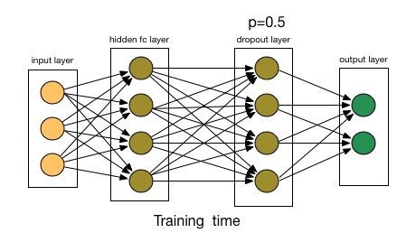
Regularization: Dropout

Slide 37
Regularization: data augmentation

Slide 38
Regularization: data augmentation

Slide 39


